Slide 1
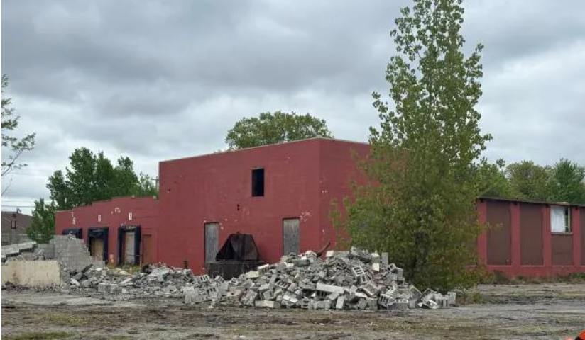

Can our town’s eyesore become an asset?
4/14/26 Webinar
Non-point Source Pollution

Slide 2
Welcome!
Introductions
Lesson Objectives and Overview
  Students will enact a model NPS pollution session to prepare for a town meeting.
  Student groups will work with varied groups of people (via role-play identities) with different goals and values.
  The goal is to agree upon and communicate the best NPS pollution site management and Land Reuse Soil (LRS) decisions to best represent the town of Granite Cliff, NH.
Webinar Components:
  Suggest ways to decrease the nonpoint source pollutants, and in turn their impacts, to the former Grouse Field Factory (GFF) site.
  Establish any regulations or site standards that have been adopted to limit nonpoint source pollution to the site.
  Develop LRS strategy options for the vacant former factory site, giving pros and cons
  Devise a method to inform your community of the results of this study.
Overview of breakout rooms, time restraints, and goals.

Slide 3
Breakout rooms – 35 minutes total
Goal 1 = 5 minutes
1
Goal 2 = 5 minutes
2
Goal 5 = 10 minutes
5
Goal 3 = 7 minutes
3
Goal 4 = 8 minutes
4

Slide 4
Breakout Room Assignments
 | BO room 1 NHDES | BO room 2 Developer | BO room 3 Homeowner/hiker
 | Charlotte Cotti | Jonathan Castricone | Catherine Kamphuis
 | Rose Muskus | Catalina Latham | Summer Campbell
 | Liza Drake | Hannah Op | Joy Fraga Muller
 | Kathleen Babcock | Marshall Davenson | Sue Moore

Slide 5
Goal 1 – 5 minutes
  Be sure everyone understands the following:
  Your group’s assigned identity/role.
    Does anyone have questions about their tasks and roles?
  Everyone should have read through the GFF parcel information on the imaginary town of Granite Cliff, NH.
    Does anyone have questions about the old GF factory site?
  Discuss the group’s discussion parameters
      Time limit per speaker?
      Handling differing opinions?
      How will the group remind someone who strays from their assigned identity?
      How to ensure that everyone who wants to speak can?
      Other?
  Reminder- throughout the webinar, your group will work within their assigned identity!

Slide 6
Goal 2 – 5 minutes
  Prompt 1: Discuss the town parcel LRS information.
    What are the weaknesses and strengths of this site?

Slide 7
Goal 3 – 7 minutes
  Benefits of Productive Reuse.
  Prompt 2: Given the site’s information and your town’s needs, discuss the following:
    Vacant land in town – Can the former GFF site be put into productive reuse?
    Benefits- jobs, activities, cleaner area, redevelopment, etc.
    Develop supporting evidence and reasons for claims

Slide 8
Goal 4 – 8 minutes
Lessen Impact of NPS Pollution to the old factory site
  Prompt 3: Suggest ways to decrease the nonpoint source pollutants, and in turn their impacts, to the site. (5 minutes)
    Testing and Mediation required
    Partnerships and Funding Ideas
      Public, State, and Federal funding and grants
      Private funds
    Prompt 4: Establish any regulations or site standards that have been adopted to limit nonpoint source pollution to the site. (3 minutes)

Slide 9
Goal 5 – 10 minutes
Old GF Factory Site Land Reuse Options for Granite Cliffs
  Prompt 5: Develop LRS strategy options for the old factory site with pros and cons
    Support your options with evidence

Slide 10
Overall group discussion/debate
35 minutes total
Welcome Back!
  8 minute sharing of each group’s ideas.
  Each group has 2 minutes to share their group’s land reuse strategy idea for the old factory site with supporting evidence.

Slide 11
Goal 6 – 15 minutes
Consensus
  Prompt 6: The overall group should come to a consensus on the main weaknesses and strengths of the town’s old factory site. (5 minutes)
  Prompt 7: The overall group should come to a consensus on the site’s impacts of threats. (5 minutes)
  Prompt 8: The overall group should come to a consensus on the best site management strategy Land Reuse options for the town of Granite Cliff. (5 minutes)

Slide 12
Goal 7 – 5 minutes
Town Policies
  Prompt 9: Decide on the town policies needed to enact the LRS management strategies for the Granite Cliffs old factory site.

Slide 13
Goal 8 – 5 minutes
Town Communication and Action
  Prompt 10: Decide on steps the committee will carry out to ensure that the process and LRS management strategy decisions are understood by the community of Granite Cliffs.

Slide 14

Wrap up
2 minutes
Congratulations!
Reflection to be done later.
Many thanks to Bob Varney of Normandeau Associates for his willingness to share his expertise and advice on Land Reuse Sites.

